Slide 1


Introduction to Robotics
Final Project Assignment 2019
Abdullah thabit

Slide 2
Contents
Task (1,2,3,4): problem statement
  Steps
  Results

Slide 3
Task 1: Problem Statement
The Control objective is the position-only without exploiting the redundancy. The required path is an horizontal square lying on the xy axis with side of 10 cm length.
The end-effector occupies the upper-left corner of the square looking from the z axis.
Each side needs to be executed with a trajectory of duration 2 s and a trapezoidal velocity profile characterized by a proper cruise velocity.
The robot stops for 200ms at each corner and 3s once back in the initial end effector position.

Slide 4
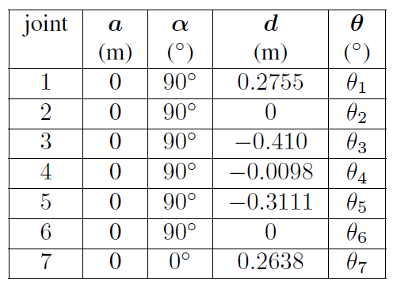
Task 1: Steps
KinovaJaco2 7-DOFs with Spherical Wrist
Provided Functions Used for Kinovato DH conversion and vice versa

Slide 5
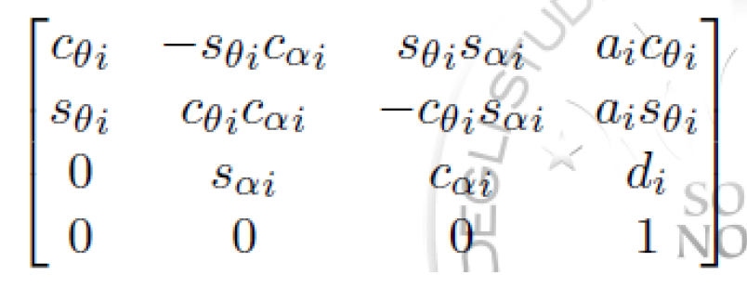
1. Getting Initial Position
From the home configuration and the DH notation is completed.
To get the rotation matrix as well as displacement of the end effector, DH table values are plugged in the homogenous transformation matrices.

Slide 6
1. Getting Initial Position
The corresponding homogenous transformation matrices are multiplied starting for the base frame to the end effector.
The multiplication result, a matrix, gives the displacement as well as rotation of the end effector.
This is result is saved as the initial displacement and the rotation of the end effector.

Slide 7
2. Calculating the desired position for each iteration
The initial displacement vector obtained by homogenous transformation matrix. ( upper left corner of the square)
The location of the other 3 corners are calculated with respect to the 1st corner, giving the length of line segments (10 cm) between corners.

Slide 8
2. Calculating the desired position for each iteration
With a sampling time Ts = 1ms, time instances are devided based on where they fall between corners :
  First line segment … (i*Ts < 2.2s)
  Second line segment … ((i*Ts)> 2.2 && (i*Ts) <= 4.4)
  Third line segment … ((i*Ts)>4.4 && (i*Ts)<=6.6)
  Forth line segment … ((i*Ts)>6.6 && (i*Ts)<=11.6)

Slide 9
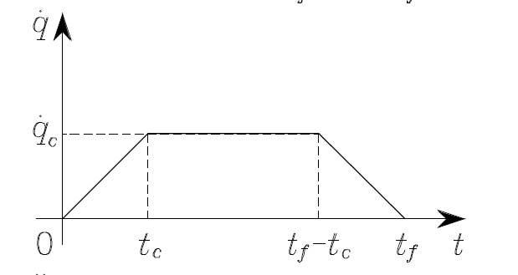
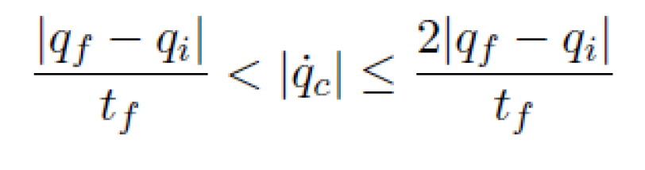
3. Trapezoidal Velocity Profile
At each line segment, the position and linear velocity of time instances were calculated using a trapezoidal velocity profile, with final time fixed to 2s
The cruise velocity is fixed according the following equation: (~=0.08 [m/s])

Slide 10
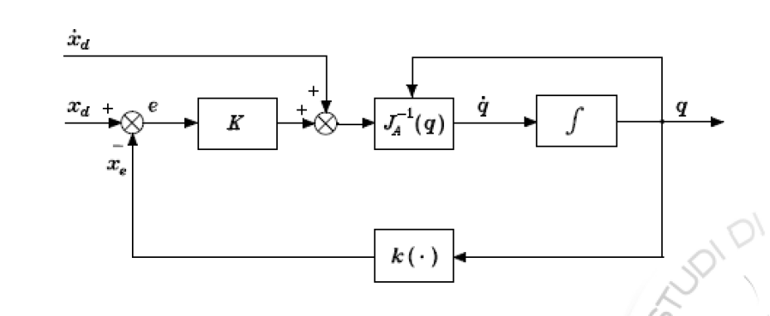
Error and Feedback
Only the positional error and the desired linear velocity is taken into consideration in this task. The following feedback is implemented to the new position at each iteration.
The joint angles are then fed to the V_rep

Slide 11
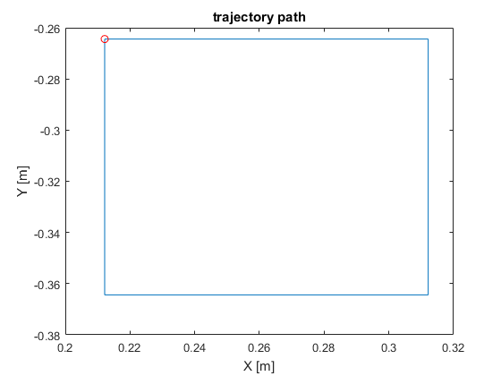
Task 1: Results

Slide 12
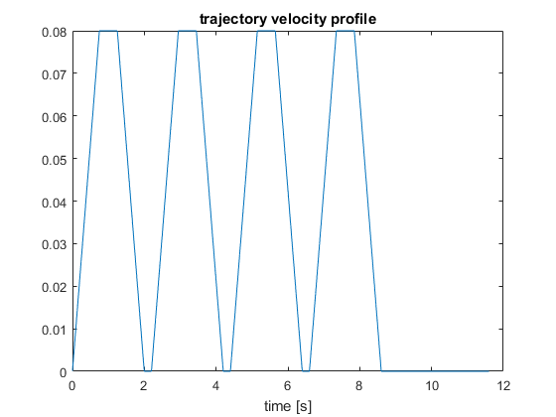
Task 1: Results

Slide 13
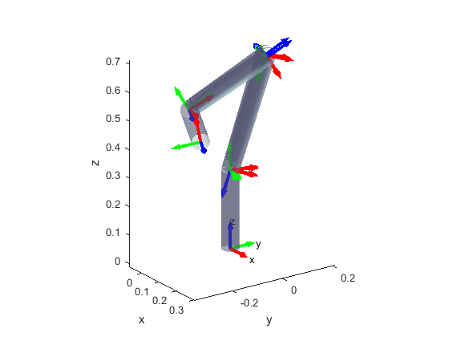
Task 1: Results

Slide 14
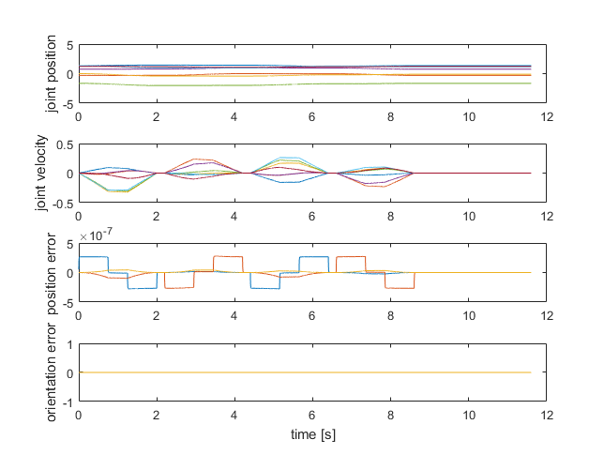
Task 1: Results

Slide 15
Task 1 Demo >>

Slide 16
Task 2: Problem Statement
In a second run, the control objective is given by both the position and the orientation. While the position needs to move according to the indications above, the orientation needs to be controlled such that it is kept constant at the initial value.

Slide 17
Task 2: Steps
The initial rotation matrix is calculated from the DH table specified by first calculating the base to end effector homogenous transformation matrix.
The transformation matrix gives the rotation matrix.
From the rotation matrix, we get the current quaternion orientation.
We set the current quaternion orientation as the desired quaternion position.

Slide 18
Adding Quaternion Error in the feedback
The quaternion error is added in the feed back by subtracting it from the current quaternion orientation.
The current quaternion orientation is calculated during each iteration.
The difference as an error is added in the error vector as the quaternion error which was previously set to 0.

Slide 19
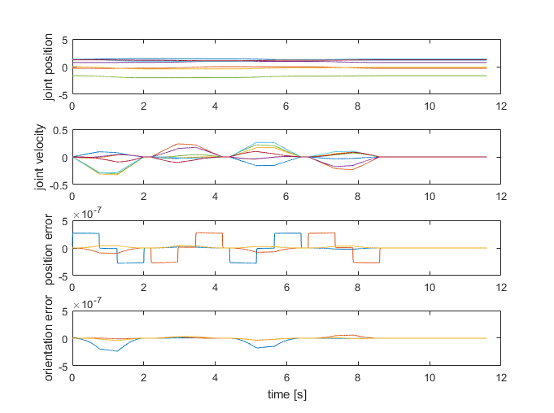
Task 2: Results

Slide 20
Task 2 Demo >>

Slide 21
Task 3: Problem Statement
In a third run the end-effector orientation needs to be changed such that, when running the first side, it is rotated of −20◦ around the zee axis according to a trapezoidal velocity profile of proper angular cruise velocity.
During the second side the inverse rotation is commanded such that, in the second corner, the orientation is equal to the initial one.
And so on …

Slide 22
Task 3: Steps
For each line segment, the rotation direction is different, therefore, different trapezoidal angular velocity profiles were obtained.
The cruise velocity is set according the constraints that were showed before.
The outputs of the trapezoidal function is the angle as well as the angular velocity.

Slide 23
Calculating The Desired Rotation
The desired rotation is calculated by calculating the rotation matrix around the Z –Axis.
The value of theta obtained from the trapezoidal function is used to calculate the rotation.
In order to get the current desired rotation, the rotation matrix calculated is multiplied with the initial rotation matrix. The multiplication is from the left since we want the rotation according to the initial base frame.

Slide 24
Quaternion Error
The desired rotation is then converted into quaternion.
Once we have converted in into quaternion, we calculate the difference between the current and desired quaternion orientation.
The Angular Velocity is only taken around the z-axis of the end effector as this is the axis around which we want the rotation.
We feed back these parameters.

Slide 25
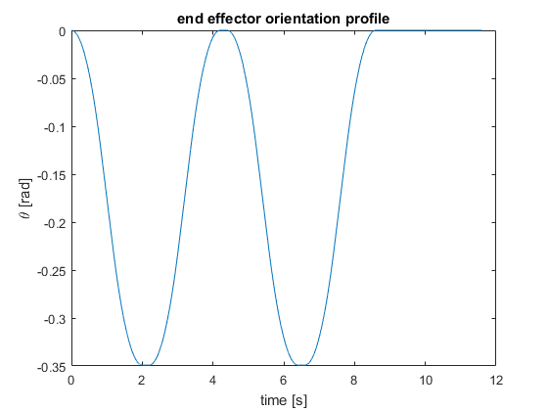
Task 3: Results

Slide 26
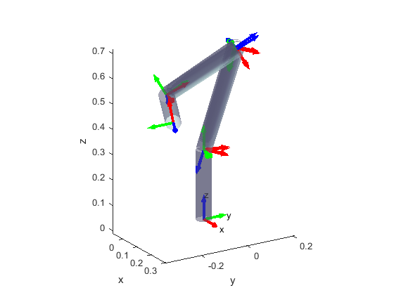
Task 3: Results

Slide 27
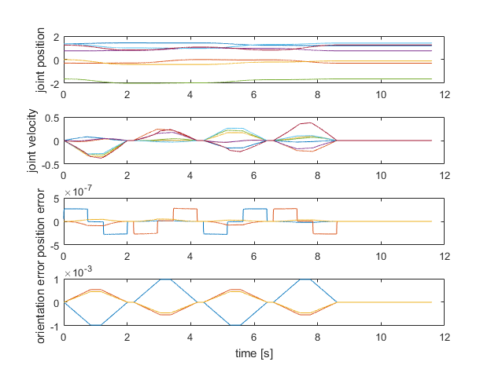
Task 3: Results

Slide 28
Task 3 Demo >>

Slide 29
Task 4: Problem Statement
Finally, with respect to the last movement, the redundancy needs to be exploited by maximizing the manipulability.

Slide 30
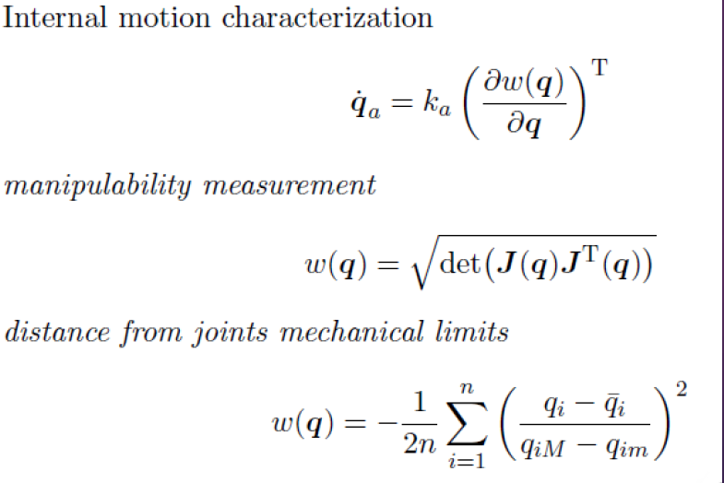
Task4: Steps
We calculate the manipulability measure by using the manipulability Jacobian provided. It is then multiplied by K_a.

Slide 31
Feedback Modification
The feedback loop is then modified to add the redundancy.

Slide 32
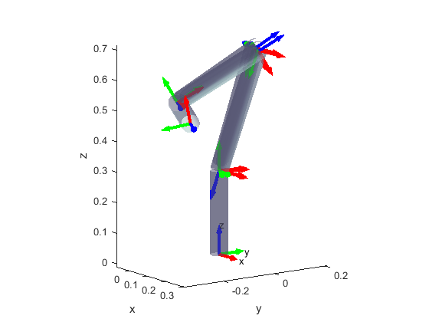
Task 4: Results

Slide 33
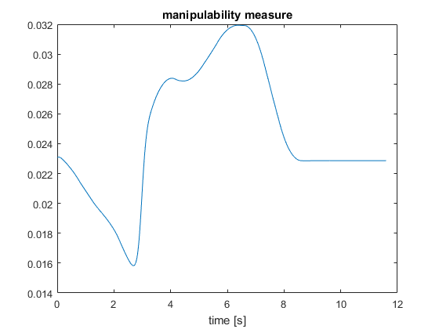
Task 4: Results

Slide 34
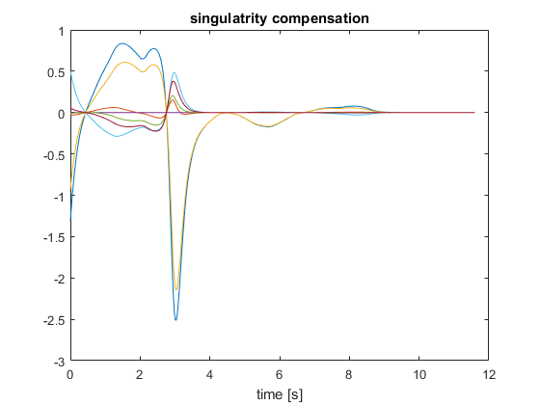
Task 4: Results

Slide 35
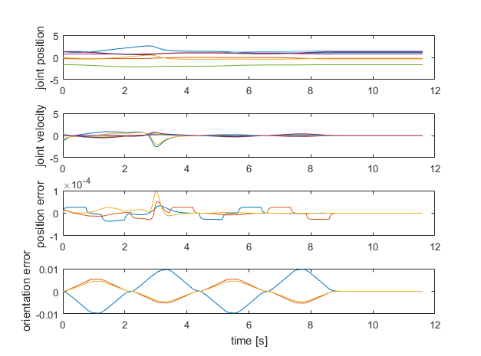
Task 4: Results

Slide 36
Task 4 Demo >>

Slide 37
THANK YOU!

